Slide 1

Unit 3

Slide 2


To learn to use comparatives with -er, more and the structure “as ... as”
Is Tom smarter than Sam?
Is Tina more outgoing than Tara.
Are you as friendly as your sister?
Does Tara work as hard as Tina?
Who’s more hard-working at school?

Slide 3


形容词或副词比较级的构成
1. 一般在词尾加-er
tall – taller
2. 以字母e结尾的词, 在词尾加-r
nice – nicer
3. 重读闭音节词词尾只有一个辅音字母时，双写该辅音字母, 再加 -er
thin – thinner
4. 以“辅音字母+y”结尾的双音节词，先把 “y”改为“i”，再加 -er
funny – funnier
5. 多音节词和部分双音节词前加more
outgoing – more outgoing

Slide 4
6. 不规则变化
原级 | 比较级
good/well | better
bad/badly | worse
many/much | more
little | less
far | farther
 | further

Slide 5


Slide 6
Compare A with B with -er, more and as ... as.
A+V+形容词/副词比较级+than+B.
Tina sings more loudly than Tara.
Does Tara sing more loudly than Tina?
Tina is more outgoing than Tara.
Is Tina more outgoing than Tara?
A+V+as+形容词/副词+as+B.
Peter’s hair is as short as Paul’s.
Is Peter’s hair as short as Paul’s?
Tom plays the guitar as well as Peter.
Does Tom play the guitar as well as Peter?

Slide 7


Complete the sentences.
1. Tom比Sam更聪明吗？
Is Tom _______ _______ Sam?
不是。Sam比Tom更聪明。
No, he isn’t. Sam is _______ _______ Tom.
smarter than
smarter than

Slide 8
2. Tara比Tina更外向吗？
Is Tara _______ _________ _______ Tina?
不是。Tina比Tara更外向。
No, she isn’t. Tina is ________ ________ ______ Tara.
3. 你和你姐姐一样友善吗？
______ you ______ friendly ______ your sister?
不是。我更友善一些。
No, I’m not. I’m __________.
more outgoing than
more outgoing than
Are
as as
friendlier

Slide 9
4. Tara和Tina一样努力吗?
Does Tara work ______ _____ ______ Tina?
是的。
Yes, she does.
5. 谁在学校更努力一些？
Who’s _________ _____________ at school?
Tina认为她比我更努力。
Tina thinks she _______ ________ than me.
as hard as
more hard-working
works harder

Slide 10


多数形容词和副词有三个等级：原级、比较级和最高级。本节主要归纳学习形容词、副词比较级的用法以及同级比较as…as结构。
原级
原级即形容词或副词的原形。
1. 表示两者在某一方面相同
as + 形容词或 副词原形 + as
e.g. This dress is as beautiful as that one.
Linda sings as well as Amy.

Slide 11
2. 表示一方在某一方面不及另一方时
not as / so + 形容词或副词原形 + as
e.g. Tom isn’t as / so tall as me.
I don’t sing as / so loudly as my sister.
3. 原级前可用very，quite，too等副词修饰
e.g. I’m very hungry.
My sister runs quite fast.
It’s too hot here.

Slide 12
比较级
两者进行比较,表示“一方比另一方更……”
1. 标志词：than
e.g. I’m more outgoing than you.
Tom jumps higher than Jack.
2. 两者中“谁更……”
特殊疑问词+谓语+比较级，A or B?
e.g. Which is better, the red dress or the black dress?
Who dances better, you or your sister?

Slide 13
3. 语境或其他词语暗示了使用比较级
e.g. Are you feeling better today?
Try to do better next time.
4. 比较级前可以用a little，much，a lot等词语修饰
e.g. The jacket is a little / much cheaper than the sweater.
Can you speak a lot more loudly?

Slide 14



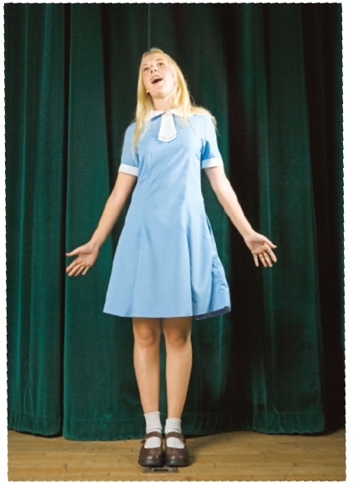
Listen to the conversation and match the people with the right things.
sang better
with shorter hair
sang more clearly
danced better
Nelly
Lisa

Slide 15
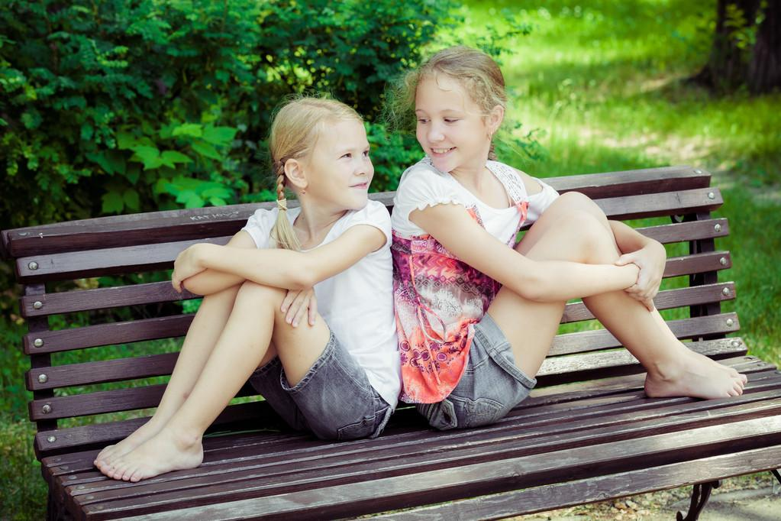
Unit 3
I’m more outgoing than my sister.

Slide 16

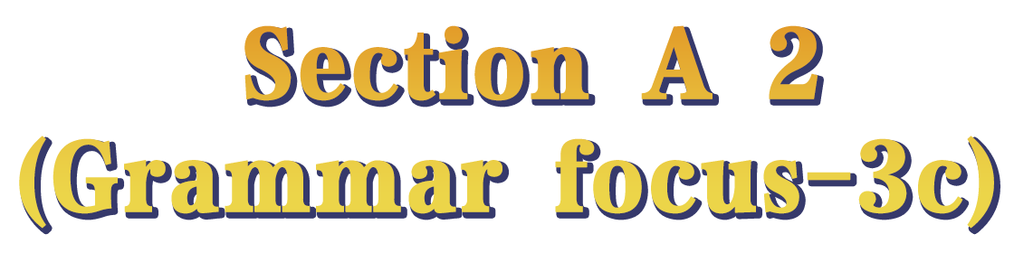

Slide 17
Let’s read!
Different people have different ideas.
What do Anna and Julie think of the singing competition and the singers?
Read the conversation and think about that.
Anna thinks the singing competition was fantastic and
the most important thing of a competition is to learn something
new and have fun.
Anna thinks Nelly sang so well and danced better than Lisa.
Julie thinks Lisa sang better and more clearly than Nelly.

Slide 18
Julie: Did you like the singing competition yesterday, Anna?
Anna：Oh, it was fantastic! Nelly sang so well.
Julie：Well, I think Lisa sang better than Nelly.
Anna：Oh, which one was Lisa?
Julie：The one with shorter hair. I think she sang more clearly than
Nelly.
Anna：Yes, but Nelly danced better than Lisa.
Julie：You can tell that Lisa really wanted to win, though.
Anna：Well, everyone wants to win. But the most important thing
is to learn something new and have fun.

Slide 19
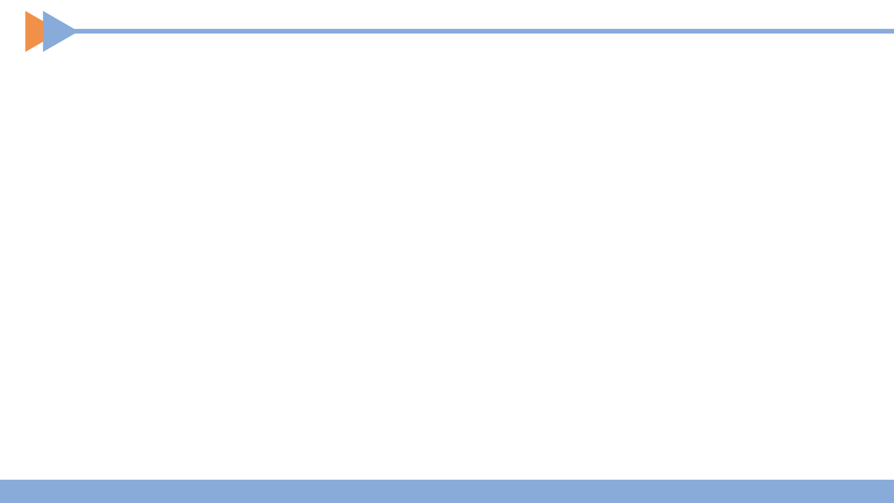


Use the words to write questions(as...as...) and answers(比较级).
1. Julie / tall / you
Q: Is Julie as tall as you?
A: No, she isn’t. She’s _______ than me.
taller
2. Jack / run / fast / Sam
Q: ____________________________
A: No, he doesn’t. He runs ______ than Sam.
Does Jack run as fast as Sam?
faster

Slide 20
3. your cousin / outgoing / you
Q: _______________________________
A: No, she isn’t. She’s ______________ than me.
Is your cousin as outgoing as you?
more outgoing
4. Paul / funny / Carol
Q: _________________________
A: No, he isn’t. He is _________ than Carol.
Is Paul as funny as Carol?
funnier

Slide 21

Think of yourself two years ago.
Write about how you are different now.
1. Are you taller?
Yes, I am. I’m taller now than I was two years ago.
2. Are you funnier?
3. Are you more outgoing?
Yes, I am. I’m funnier now than I was two years ago.
Yes, I am. I’m more outgoing now than I was two years ago.

Slide 22
4. Do you study English harder?
5. Do you sing better?
Yes, I do. I study English harder now than I did two years ago.
Yes, I do. I sing better now than I did two years ago.
当than前后所使用的动词相同时，可用助动词代替。

Slide 24
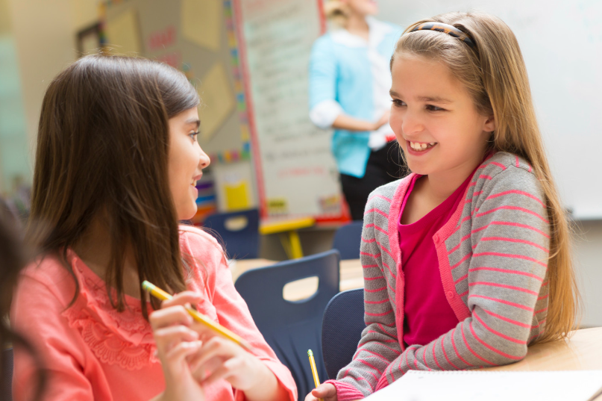
Read the conversation.
adj. 极好的; 了不起的
Did you like the singing competition yesterday, Anna?
Oh, it was fantastic! Nelly sang so well.
n. 比赛; 竞赛; 竞争
Julie Anna

Slide 25
Well, I think Lisa sang better than Nelly.
Oh, which one was Lisa?
pron. & adj.
哪一个; 哪一些
The one with shorter hair. I think she sang more clearly than Nelly.
Yes, but Nelly danced better than Lisa.
Julie Anna
adv. 清楚地; 清晰地; 明白地

Slide 26
Well, everyone wants to win. But the most important thing is to learn something new and have fun.
You can tell that Lisa really wanted to win, though.
v. 获胜; 赢; 赢得
adv. 不过; 可是; 然而
conj. 虽然
Julie Anna

Slide 27
Role play the conversation.
Julie: Did you like the singing competition yesterday, Anna?
Anna：Oh, it was fantastic! Nelly sang so well.
Julie：Well, I think Lisa sang better than Nelly.
Anna：Oh, which one was Lisa?
Julie：The one with shorter hair. I think she sang more clearly than
Nelly.
Anna：Yes, but Nelly danced better than Lisa.
Julie：You can tell that Lisa really wanted to win, though.
Anna：Well, everyone wants to win. But the most important thing
is to learn something new and have fun.

Slide 28
Fill in the blanks according to the conversation.
Anna liked the singing competition. It was ________. Julie thought Lisa, the one with _______ hair, sang ______ and ___________ than Nelly. Anna thought Nelly danced ______ than Lisa. All in all, the _______________ thing is to learn something new and have fun.
fantastic
shorter
better
more clearly
better
most important

Slide 29


Compare your parents. Check (√) who is smarter, funnier, etc. in the chart. Then ask your partner about his / her parents.
A: Who is smarter, your mother or your father?
B: I think my mother is smarter than my father.

Slide 30
 | Mother | Father
smart
funny
work hard
outgoing
friendly
sing well
√

Slide 31

1. My brother Bob is ____ hard-working than me, but I am ____ than him. (2021贵州毕节)
A. most; funnier B. most; funniest
C. more; fun D. more; funnier
2. My brother is much _____ than me now. He grows really fast.
A. tall B. taller
C. tallest D. the tallest (2021广西河池)
D
B

Slide 32
3. Jane has become _____ than before. She can express herself in public now. (2021辽宁朝阳)
A. much outgoing B. most outgoing
C. more outgoing D. less outgoing
C
4. Guilin isn’t as _____ as Beijing. (2021广西桂林)
A. big B. bigger C. biggest
5. Dr. Yuan Longping had a dream that he could develop rice as _____ as peanuts (花生). (2021湖北黄石)
A. large B. largest C. larger D. the largest
A
A

Slide 33
6. I think there’s no need to buy such an expensive coat for a kid. I’d like a ____ one. (2021四川广元)
A. cheap B. cheaper C. cheapest D. lower
B
7. Credit cards (信用卡) matter a lot _____ than before. We usually pay with smart phones now.
A. little B. fewer C. less D. more
(2021辽宁营口)
C

Slide 34
8. —Lucy, have you changed a mobile phone with 5G?
—Yes, I think the mobile phone with 5G can send videos much ____ than the one with 4G. (2021湖北鄂州)
A. fast B. fastest C. the fastest D. faster
D
9. Children usually play this kind of word game _____ than grown-ups. (2021福建)
A. well B. better C. best
B

Slide 35


I. 根据语境及括号内所给单词的提示填空。
1. —Is here quiet?
—Yes, but I know somewhere much _______(quiet).
2. Their house is as _______(big) as mine.
3. The math test was _____________(difficult) than the English test. Few students passed (通过) the test.
4. She looks __________(young) than me, but in fact she is much _______(old).
5. Tina didn’t swim as _______(well) as Alice.
quieter
big
more difficult
younger
older
well

Slide 36
II. 根据语境及所给提示词语，完成下列对话。
1. go there / by car / long / by train
Q: __________________________________________________?
A: Yes, it does. It takes four hours by car and five hours by train.
2. Sam / early / Molly
Q: ________________________________________?
A: No, he didn’t. Molly was a little _______. Sam arrived at about 4:00, but Molly arrived at 3:35.
Does it take longer to go there by train than by car
Did Sam arrive earlier than Molly
earlier

Slide 37
3. Mark / reach / high / Peter
Q: ______________________________________________?
A: No, he can’t. Mark isn’t as tall as Peter.
4. who / outgoing / Linda / Cindy
Q: ______________________________________________?
A: I think Linda is __________________ than Cindy. Cindy is very quiet.
Can Mark reach as high as Peter / Can Mark reach higher than Peter
Who is more outgoing, Linda or Cindy
more outgoing

Slide 38
5. Tim / play basketball / well / Dave / as
Q: _____________________________________________?
A: No, he doesn’t. Dave plays basketball __________ than Tim. Tim isn’t interested in basketball at all.
6. you / good / today / yesterday
Q: _____________________________________________?
A: Yes, I do. Yesterday I felt terrible, but today I feel OK.
Does Tim play basketball as well as Dave
better
Do you feel better today than yesterday

Slide 39
III. 根据短文内容及括号内所给汉语提示补全短文。
Look at Helen and Jenny in the picture. They are my classmates and they are also twin sisters (孪生姐妹). They are both tall, but (1)________________________________(Jenny比Helen瘦得多). They both have curly hair, but (2)__________________________( Helen的头发看起来长点儿). They like different sports. Helen likes swimming, because (3)___________________________________________________ (游泳比任何其他运动都有趣) in her eyes.
Jenny is much thinner than Helen
Helen’s hair looks longer
swimming is more interesting than any other sport

Slide 40
However, Jenny likes running because she thinks (4)_____________________________________(跑步比游泳更有用). At school, (5)_____________________________________ (Helen和Jenny一样努力学习). They always get good grades. I am different from them. (6)______________________________ (我没有他们那么勤奋) so I do badly in my studies. Luckily, they help me a lot and now we are good friends.
running is more useful than swimming
Helen studies as hard as Jenny
I’m less hard-working than them

Slide 41
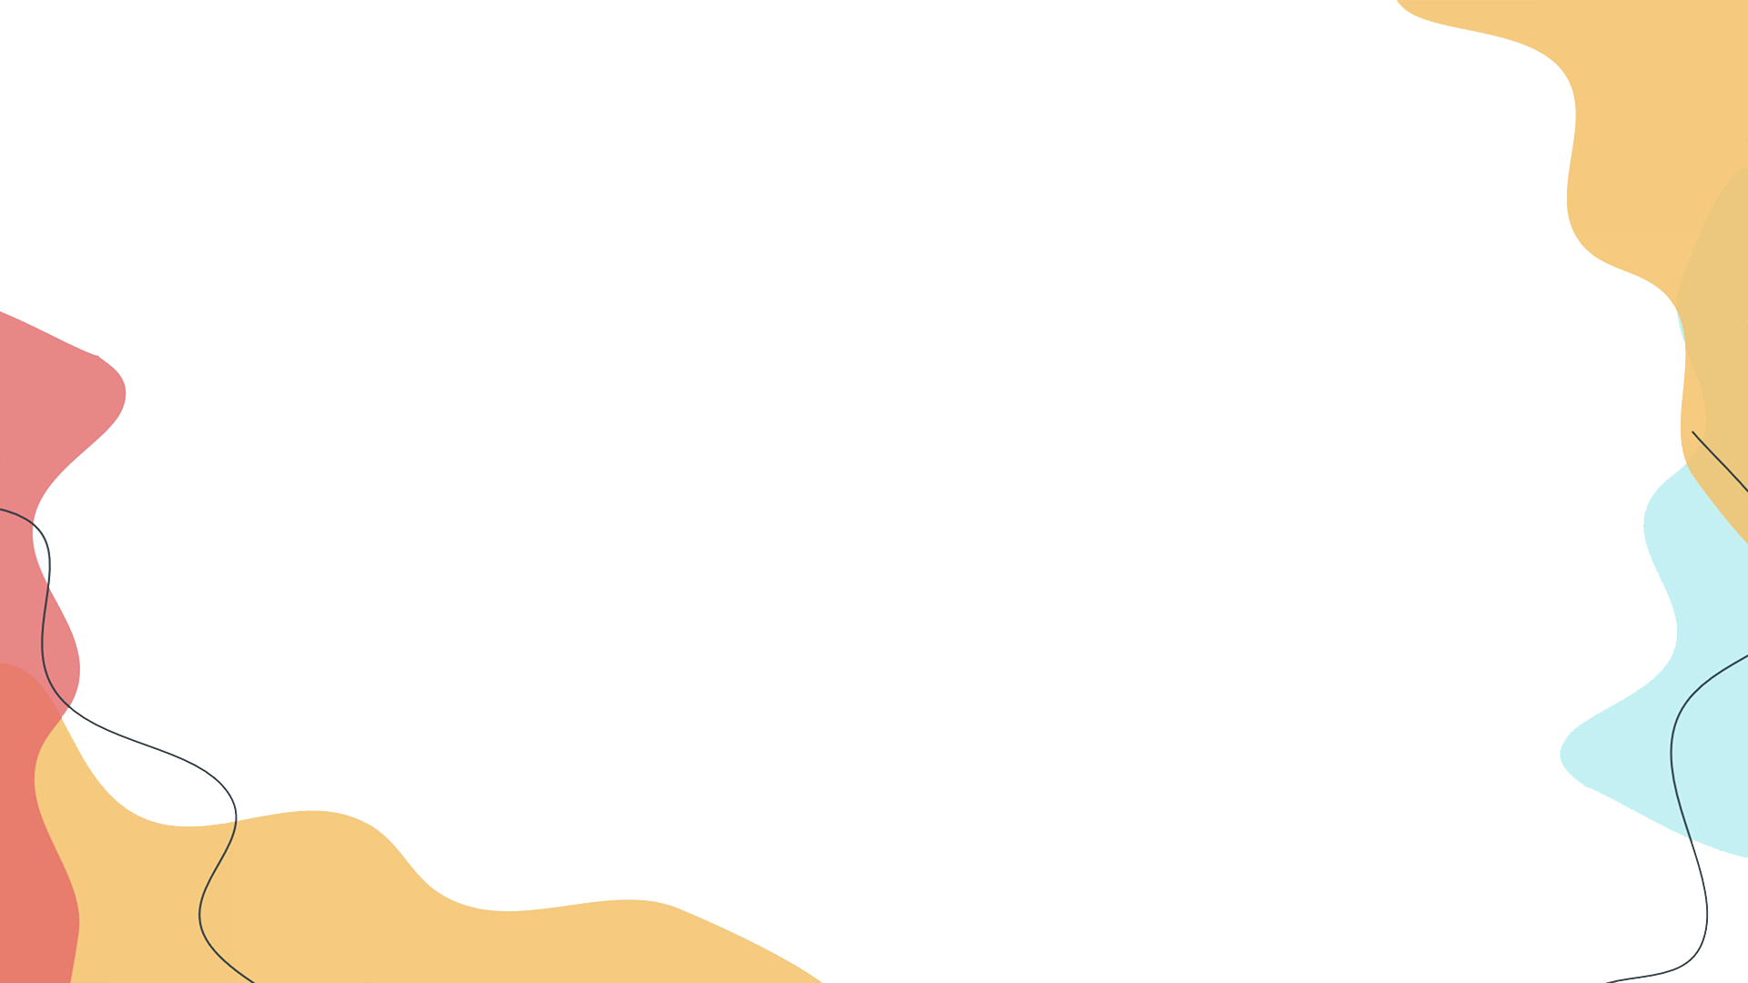

1. Compare one of your best friends with you. Write a passage about the same and different things between you two in about 50 words.
2. Preview 1a-1e on page 20.

Slide 42
